Slide 1
E-retail factors for customer activation & retention
In this dataset we need to perform EDA & visualization on every column which is factor affecting the customer’s intereset in a given online E-commerce website and preventing them to move on to another E-commerce website.

Slide 2
Steps taken before EDA was performed
Imported necessary libraries for task to be completed.
Loaded dataset on jupyter notebook using pandas library.
Checked the dimension of the dataset which was showing that dataset contains 269 rows & 71 columns.
Checked description of dataset which gives information of mean, min value, max value, etc of every column in dataset which contains continuous data in it & it shows that only one column contains continuous data in it named (4What is the Pin Code of where you shop online from?).
Checked name of every column present in dataset.
5:

Slide 3
Assumptions made before EDA was performed.
There is no target column is present in the dataset.
Only univariate analysis of every column must be performed.
No bivariate analysis is needed as no target column is available.

Slide 4
Exploratory Data Analysis

Slide 5
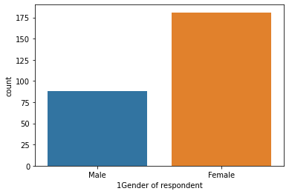
1. Gender of respondent
Checked unique values of the column.
There was no null value present in the column.
From visualization we concluded that most people visiting E-commerce sites are Female.

Slide 6
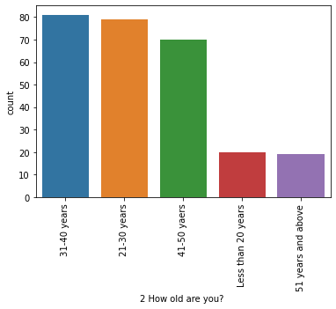
2. How old are you?
Checked unique values of the column.
There was no null value present in the column
From visualization we conclude that most people visiting E-commerce websites age between 31-40 years.

Slide 7
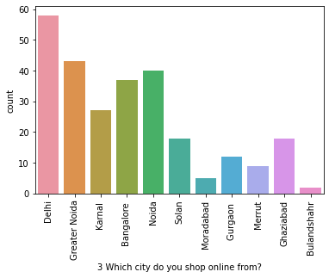
3. Which city do you shop online from?
Checked unique values of the column.
There was no null value present in the column
From visualization we conclude that most people doing shopping are from city Delhi.

Slide 8
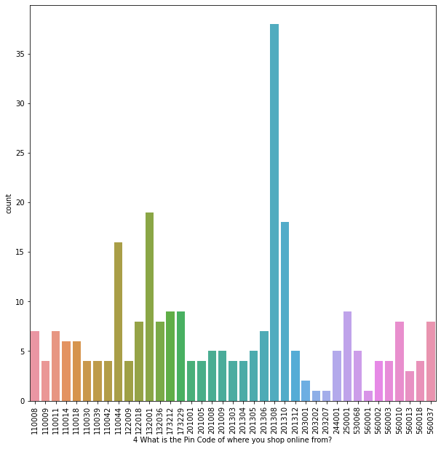
4. What is the Pin Code of where you shop online from?
Checked unique values of the column.
There was no null value present in the column
From visualization we concluded that most people doing online shopping are residing in area whose pin code is 201308

Slide 9
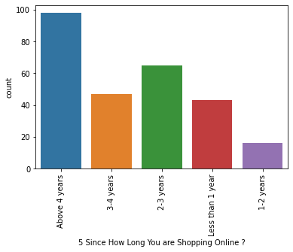
5. Since How Long You are Shopping Online?
Checked unique values of the column.
There was no null value present in the column
From visualization we concluded that most people doing shopping on these websites are doing it for more than past 4 years.

Slide 10
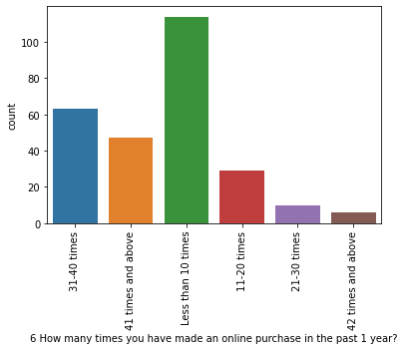
6. How many times you have made an online purchase in the past 1 year ?
Checked unique values of the column.
There was no null value present in the column
From visualization we concluded that most people purchased items from these sites has done purchasing less than 10 times in past 1 year.

Slide 11
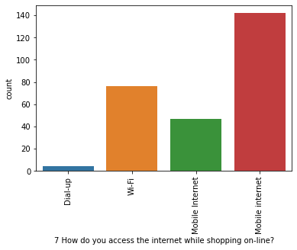
7. How do you access the internet while shopping on-line?
Checked unique values of the column.
There was no null value present in the column
From visualization we concluded that most people accessing internet are using mobile internet as their medium

Slide 12
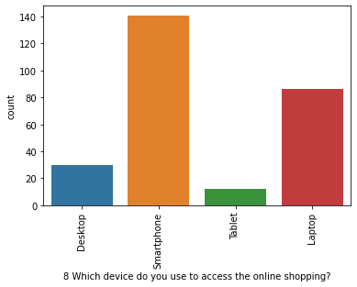
8. Which device do you use to access the online shopping?
Checked unique values of the column.
There was no null value present in the column
From visualization we concluded that most people doing online shopping are using Smartphones for doing it.

Slide 13
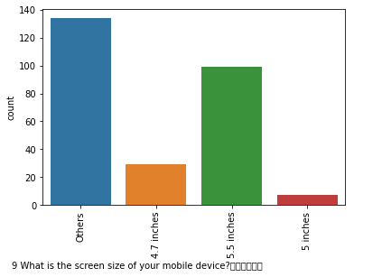
9. What is the screen size of your mobile device?
Checked unique values of the column.
There was no null value present in the column
From visualization we concluded that most people’s doing online shopping using mobile device have their mobile’s screen size registered as others

Slide 14
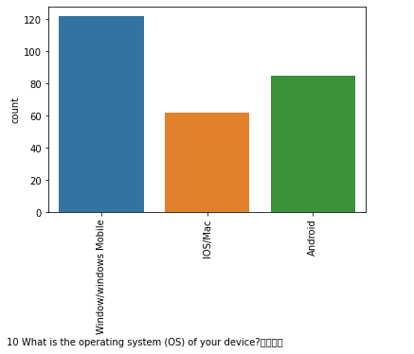
10. What is the operating system (OS) of your device?
Checked unique values of the column.
There was no null value present in the column
From visualization we concluded that most people doing online shopping are doing it using device which contains Windows/windows Mobile as Operating System (OS)

Slide 15
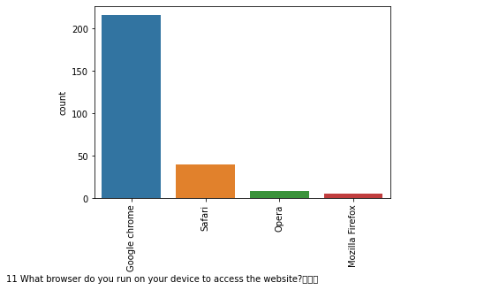
11. What browser do you run on your device to access the website?
Checked unique values of the column.
There was no null value present in the column
From visualization we concluded that most people doing online shopping are using Chrome web browser to do it.

Slide 16
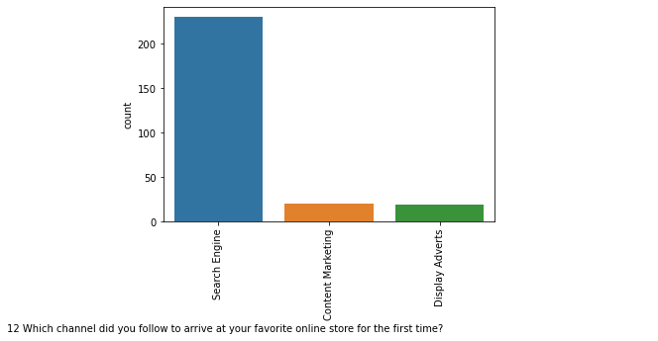
12. Which channel did you follow to arrive at your favorite online store for the first time?
Checked unique values of the column.
There was no null value present in the column
From visualization we concluded that most used Search Engine as the channel to arrive at online store for first time.

Slide 17
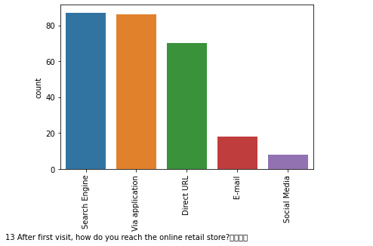
13. After first visit, how do you reach the online retail store?
Checked unique values of the column.
There was no null value present in the column
From visualization we concluded that most people visiting online retail store after first visit via search engine.

Slide 18
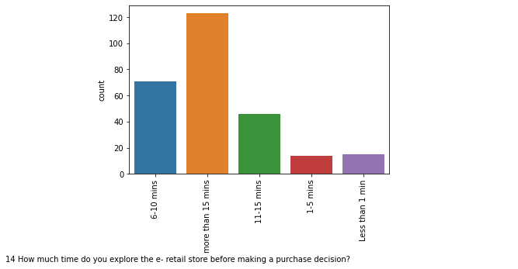
14. How much do you explore the e-retail store before making a purchase decision?
Checked unique values of the column.
There was no null value present in the column
From visualization we concluded that most people explore e-retail store more than 15 times before making a purchase decision.

Slide 19
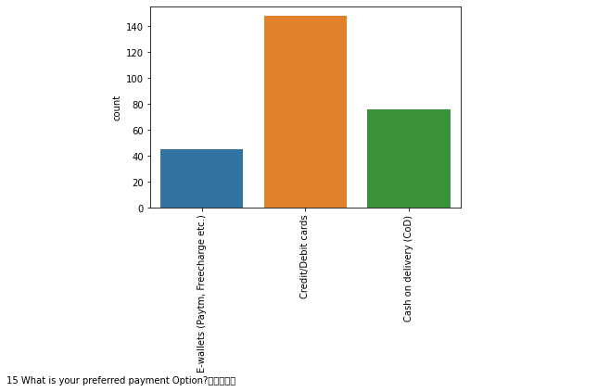
15. What is your preferred payment option?
Checked unique values of the column.
There was no null value present in the column
From visualization we concluded that most people prefer to make payments via credit/debit cards

Slide 20
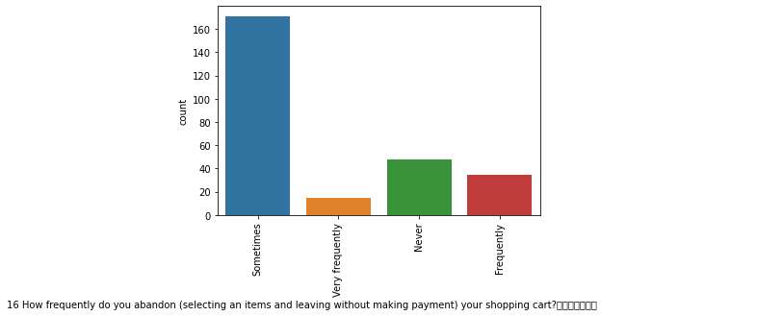
16. How frequently do you abandon (selecting an items and leaving without making payment) your shopping cart?
Checked unique values of the column.
There was no null value present in the column
From visualization we concluded that most people abandon their shopping cart sometimes.

Slide 21
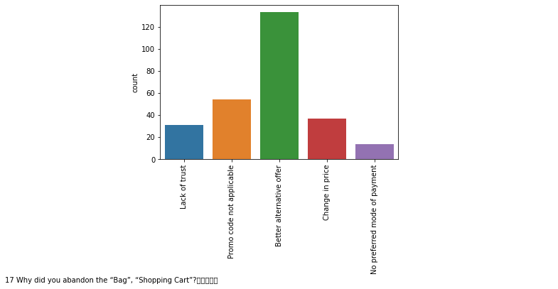
17. Why did you abandon the “Bag”, “Shopping Cart”?
Checked unique values of the column.
There was no null value present in the column
From visualization we concluded that most people abandon the shopping cart because of better alternative offer

Slide 22
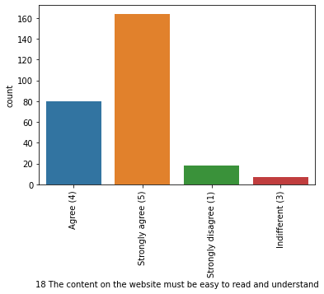
18. The content on the website must be easy to read and understand
Checked unique values of the column.
There was no null value present in the column
From visualization we concluded that most people strongly agree that content on website must be easy to read & understand.

Slide 23
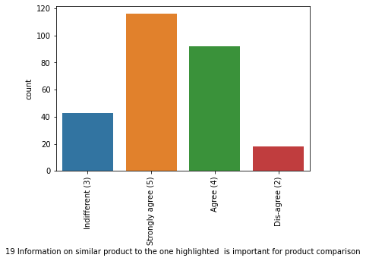
19. Information on similar product to the one highlighted is important for product comparison
Checked unique values of the column.
There was no null value present in the column
From visualization we concluded that most people strongly agree that Information on similar product to the one highlighted is important for product comparison

Slide 24
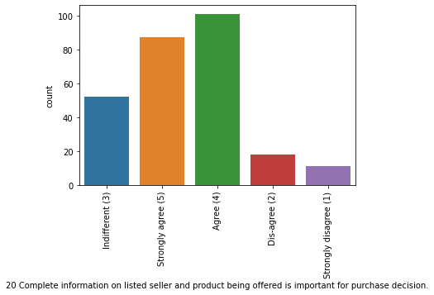
20. Complete information on listed seller and product being offered is important for purchase decision
Checked unique values of the column.
There was no null value present in the column
From visualization we concluded that most people agree that Complete information on listed seller and product being offered is important for purchase decision

Slide 25
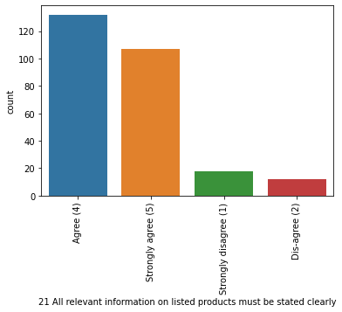
21. All relevant information on listed products must be stated clearly
Checked unique values of the column.
There was no null value present in the column
From visualization we concluded that most people agree that all relevant information on listed products must be stated clearly

Slide 26
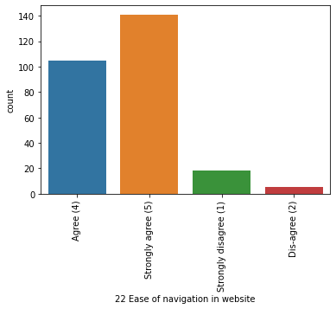
22. Ease of navigation in website
Checked unique values of the column.
There was no null value present in the column
From visualization we concluded that most people strongly agree for ease of navigation in website.

Slide 27
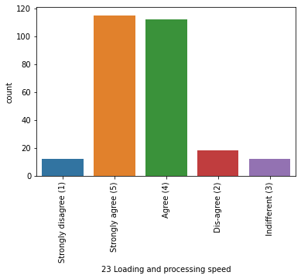
23. Loading and processing speed
Checked unique values of the column.
There was no null value present in the column
From visualization we concluded that most people strongly agree that e-retail should have better loading & processing speed

Slide 28
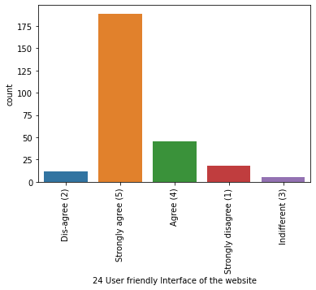
24. User friendly interface of website
Checked unique values of the column.
There was no null value present in the column
From visualization we concluded that most people strongly agree that website should have user friendly interface

Slide 29
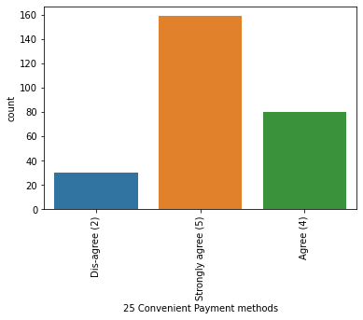
25. Convenient Payment methods
Checked unique values of the column.
There was no null value present in the column
From visualization we concluded that most people strongly agree that e-retail store should have convenient payment methods

Slide 30
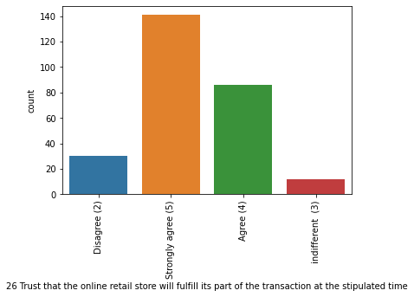
26. Trust that the online retail store will fulfill its part of the transaction at the stipulated time
Checked unique values of the column.
There was no null value present in the column
From visualization we concluded that most people strongly agree that e-retail store would fulfil its part of transaction at the stipulated time

Slide 31
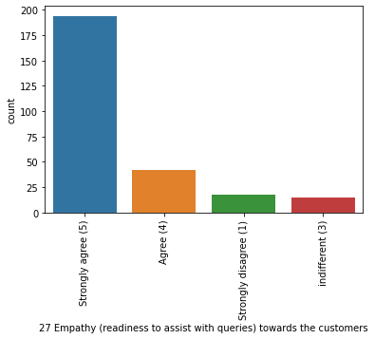
27. Empathy (readiness to assist with queries) towards the customers
Checked unique values of the column.
There was no null value present in the column
From visualization we concluded that most people strongly agree that e-retail store should have empathy towards customers

Slide 32
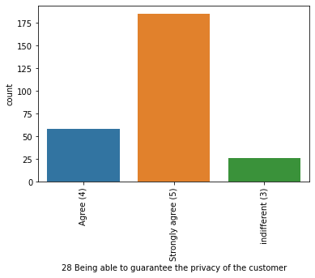
28. Being able to guarantee the privacy of the customer
Checked unique values of the column.
There was no null value present in the column
From visualization we concluded that most people strongly agree that e-retail store should make guarantee to provide privacy of the customer

Slide 33
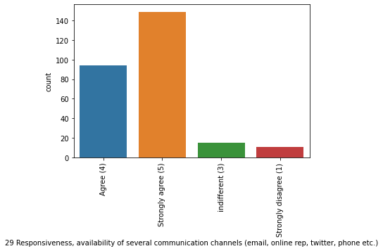
29. Responsiveness availability of several communication channels (email, online rep, twitter, phone, etc)
Checked unique values of the column.
There was no null value present in the column
From visualization we concluded that most people strongly agree that e-retail store should more than one responsiveness communication channels

Slide 34
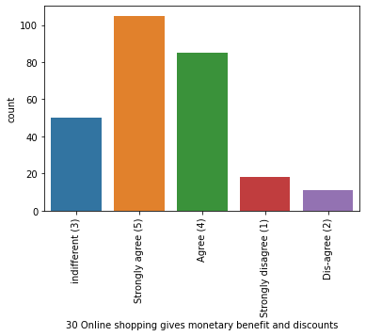
30. Online shopping gives monetary benefit and discounts
Checked unique values of the column.
There was no null value present in the column
From visualization we concluded that most people strongly agree that online shopping should give monetary benefit and discounts

Slide 35
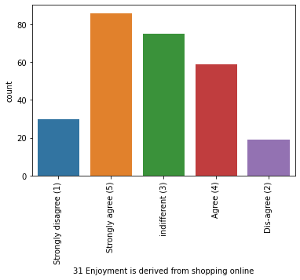
31. Enjoyment is derived from shopping online
Checked unique values of the column.
There was no null value present in the column
From visualization we concluded that most people strongly agree that enjoyment is derived from shopping online

Slide 36
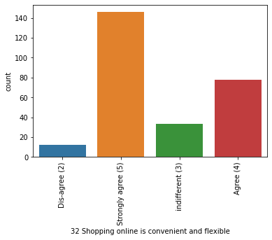
32. Shopping online is convenient and flexible
Checked unique values of the column.
There was no null value present in the column
From visualization we concluded that most people strongly agree that shopping online is convenient and flexible

Slide 37
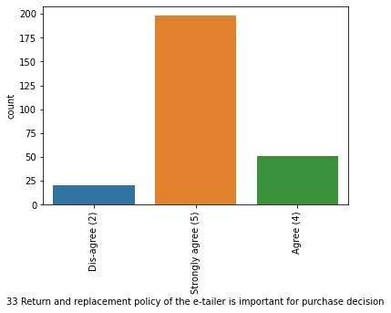
33. Return & replacement policy of the e-tailer is important for purchase decision
Checked unique values of the column.
There was no null value present in the column
From visualization we concluded that most people strongly agree that return & replacement policy of e-tailer is important for purchase decision

Slide 38
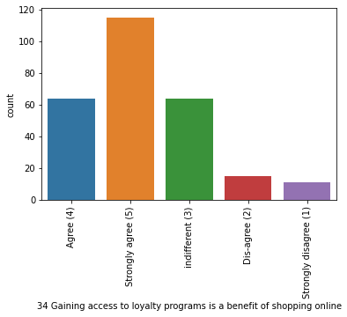
34. Gaining access to loyalty programs is a benefit of shopping online
Checked unique values of the column.
There was no null value present in the column
From visualization we concluded that most people strongly agree that gaining access to loyalty programs is a benefit of shopping online

Slide 39
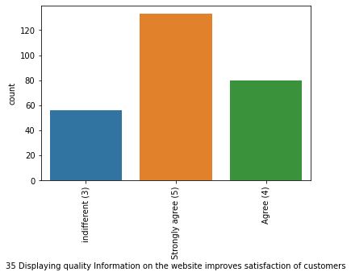
35. Displaying quality information on the website improves satisfaction of customers
Checked unique values of the column.
There was no null value present in the column
From visualization we concluded that most people strongly agree that displaying quality information on website improves customer satisfaction.

Slide 40
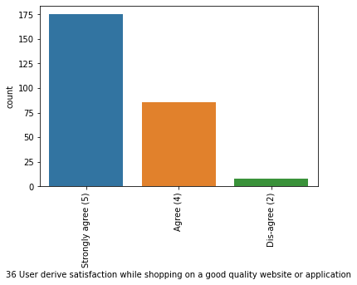
36. User derive satisfaction while shopping on a good quality website or application
Checked unique values of the column.
There was no null value present in the column
From visualization we concluded that most people strongly agree that user derive satisfaction can be achieved by providing good quality online shopping website or application

Slide 41
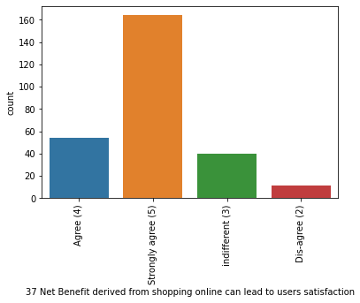
37. Net Benefit derived from shopping online can lead to user satisfaction
Checked unique values of the column.
There was no null value present in the column
From visualization we concluded that most people strongly agree that net benefit derived from shopping online can lead to user satisfaction

Slide 42
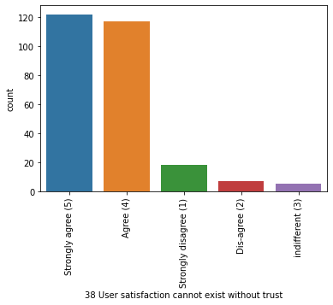
38. User satisfaction cannot exist without trust
Checked unique values of the column.
There was no null value present in the column
From visualization we concluded that most people strongly agree that user satisfaction cannot exist without trust

Slide 43
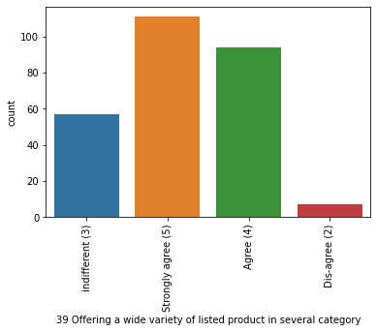
39. Offering a wide variety of listed product in several category
Checked unique values of the column.
There was no null value present in the column
From visualization we concluded that most people strongly agree that e-retail store should offer a wide variety of listed product in several category

Slide 44
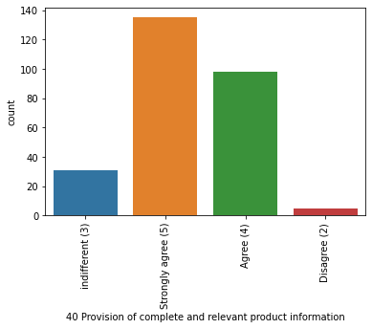
40. Provision of complete & relevant product information
Checked unique values of the column.
There was no null value present in the column
From visualization we concluded that most people strongly agree that there should be provision of complete & relevant product information on e-retail stores

Slide 45
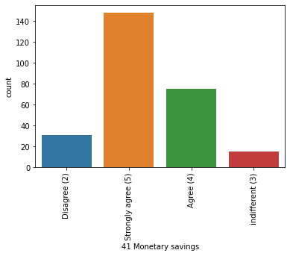
41. Monetary savings
Checked unique values of the column.
There was no null value present in the column
From visualization we concluded that most people strongly agree that e-retail stores provide monetary savings

Slide 46
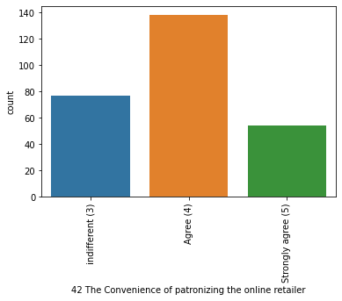
42. The convenience of patronizing the online retailer.
Checked unique values of the column.
There was no null value present in the column
From visualization we concluded that most people agree about convenience of patronizing online retailer

Slide 47
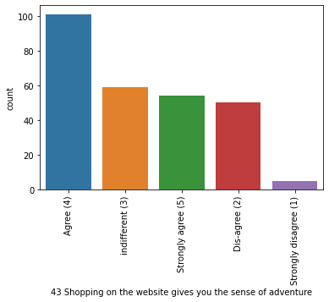
43. Shopping on the website gives you the sense of adventure
Checked unique values of the column.
There was no null value present in the column
From visualization we concluded that most people agree that shopping online gives them sense of adventure

Slide 48
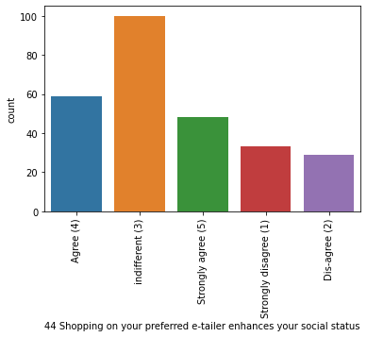
44. Shopping on your preferred e-tailer enhances your social status
Checked unique values of the column.
There was no null value present in the column
From visualization we concluded that most people feel indifferent about shopping on your preferred e-tailer enhances your social status

Slide 49
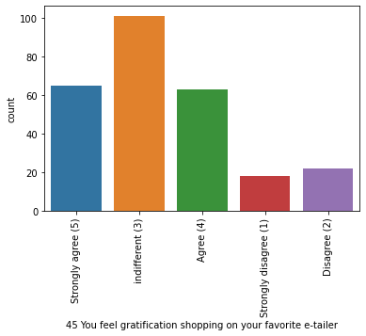
45. You feel gratification shopping on your favorite e-tailer
Checked unique values of the column.
There was no null value present in the column
From visualization we concluded that most people feel indifferent about feeling gratification shopping on their favorite e-tailer

Slide 50
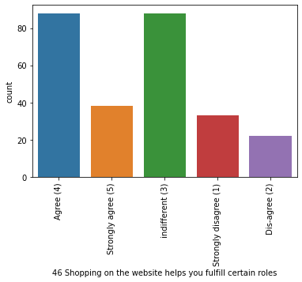
46. Shopping on the website helps you fulfill certain roles
Checked unique values of the column.
There was no null value present in the column
From visualization we concluded that people with both categories (Agree & indifferent) are having ame amount of votes about shopping on website helps in fulfilling certain roles

Slide 51
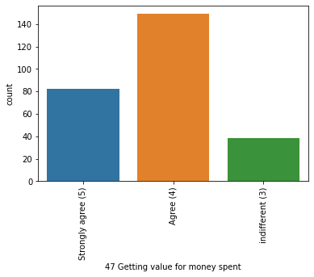
47. Getting value for money spent
Checked unique values of the column.
There was no null value present in the column
From visualization we concluded that most people agree that they are getting value for money they spent

Slide 52
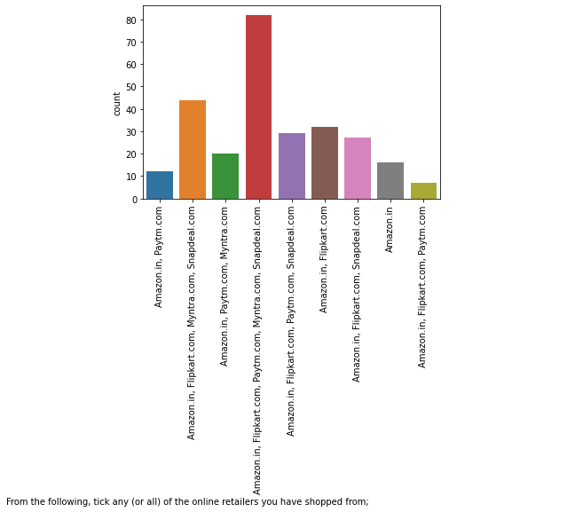
48. From the following, tick any (or all) of the online retailers you have shopped from
Checked unique values of the column.
There was no null value present in the column
From visualization we concluded that most people are visiting cluster of Amazon.in, Flipkart.com, Paytm.com, myntra.com & snapdeal.com website

Slide 53
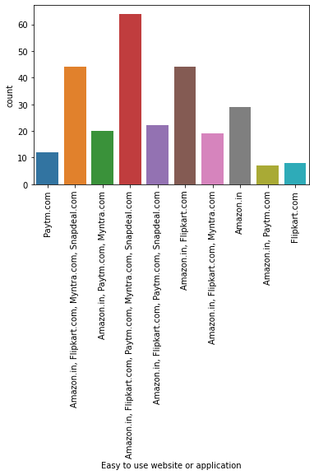
49. Easy to use website or application
Checked unique values of the column.
There was no null value present in the column
From visualization we concluded that most people feel that easy to use website or application are of Amazon.in, Flipkart.com, Paytm.com, myntra.com & snapdeal.com

Slide 54
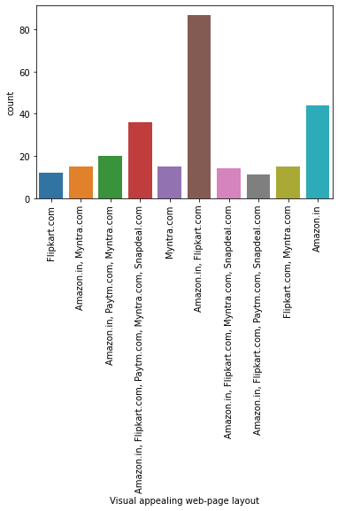
50. Visual appealing web-page layout
Checked unique values of the column.
There was no null value present in the column
From visualization we concluded that most people that qmost visual appealing web-page layout are of Amazon.in & Flipkart.com websites

Slide 55

51. Wild variety of product on offer
Checked unique values of the column.
There was no null value present in the column
From visualization we concluded that most wild variety of product on offer are present on Amazon.in & Flipkart.com website

Slide 56

52. Complete, relevant description information of products
Checked unique values of the column.
There was no null value present in the column
From visualization we concluded that most complete, relevant information of products are available on Amazon.in & Flipkart.com websites

Slide 57

53. Fast loading website speed of website and application
Checked unique values of the column.
There was no null value present in the column
From visualization we concluded that most people thinks that Amazon.in has fast loading website & application speed

Slide 58

54. Reliability of the website or application
Checked unique values of the column.
There was no null value present in the column
From visualization we concluded that most people thinks that most reliable website or application is of Amazon.in

Slide 59

55. Quickness to complete purchase
Checked unique values of the column.
There was no null value present in the column
From visualization we concluded that most people thinks Amazon.com provides quickness to complete purchase

Slide 60

56. Availability of several payment options
Checked unique values of the column.
There was no null value present in the column
From visualization we concluded that most people think that Amazon.in & Flipkart.com have several payment options

Slide 61

57. Speedy order delivery
Checked unique values of the column.
There was no null value present in the column
From visualization we concluded that most people think that Amazon.in has speedy order delivery

Slide 62

58. Privacy of customer’s information
Checked unique values of the column.
There was no null value present in the column
From visualization we concluded that most people think Amazon.in provides privacy of customer’s information

Slide 63

59. Security of customer financial information
Checked unique values of the column.
There was no null value present in the column
From visualization we concluded that most people think that Amazon.in provides security of customer financial information

Slide 64

60. Perceived Trustworthiness
Checked unique values of the column.
There was no null value present in the column
From visualization we concluded that most people think that Amazon.in provides Perceived Trustworthiness

Slide 65

61. Presence of online assistance through multi-channel
Checked unique values of the column.
There was no null value present in the column
From visualization we concluded that most people think that Amazon.in, Flipkart.com, Myntra.com & snapdeal.com websites provides presence of online assistance through multi-channel

Slide 66

62. Longer time to get logged in (promotion, sales period)
Checked unique values of the column.
There was no null value present in the column
From visualization we concluded that most people think that Amazon.in website takes longer time to get logged in (promotion, sales period)

Slide 67

63. Longer time in displaying graphics & photos (promotion, sales period)
Checked unique values of the column.
There was no null value present in the column
From visualization we concluded that most people think that Amazon.in & Flipkart.com websites takes longer time in displaying graphics & photos (promotion, sales period)

Slide 68

64. Late declaration of price (promotion, sales period)
Checked unique values of the column.
There was no null value present in the column
From visualization we concluded that most people think that Myntra.com website provide late declaration of price

Slide 69

65. Longer page loading time (promotion, sales period)
Checked unique values of the column.
There was no null value present in the column
From visualization we concluded that most people think that Myntra.com website takes longer page loading time (promotion, sales period)

Slide 70

66. Limited mode of payment on most products (promotion, sales period)
Checked unique values of the column.
There was no null value present in the column
From visualization we concluded that most people think that Snapdeal.com website has limited mode of payment on most products (promotion, sales period)

Slide 71

67. Longer delivery period
Checked unique values of the column.
There was no null value present in the column
From visualization we concluded that most people think that Paytm.com website takes longer delivery period.

Slide 72

68. Change in website/Application design
Checked unique values of the column.
There was no null value present in the column
From visualization we concluded that most people think that there is a change in website/Application design of Amazon.in

Slide 73

69. Frequent disruption when moving from one page to another
Checked unique values of the column.
There was no null value present in the column
From visualization we concluded that most people think that Amazon.in has frequent disruption when moving from one page to another

Slide 74

70. Website is as efficient as before
Checked unique values of the column.
There was no null value present in the column
From visualization we concluded that most people think that Amzon.in website is as efficient as before

Slide 75

71. Which of the Indian online retailer would you recommended to a friend?
Checked unique values of the column.
There was no null value present in the column
From visualization we concluded that most people think that they would recommend Amazon.in online retail store to a friend

Slide 76
THE END

